Slide 1

Gerrymandering in the Laboratory
 | Cary Deck
Michael Anderson |  | SunAh An
The University of Alabama
Contests: Theory and Evidence
August 2021

Slide 2
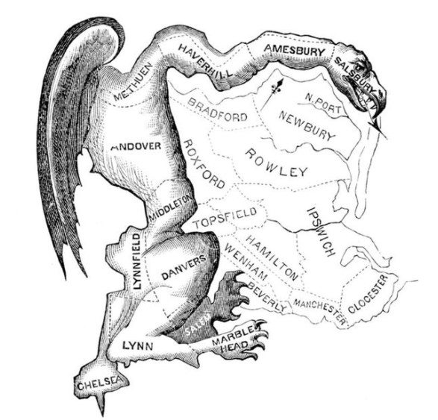
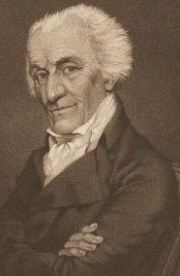
Gerrymandering
Gerrymandering is the manipulation of the boundaries of electoral constituencies to favor one election outcome over another
Gerry’s Salamander
In 1812, Massachusetts Governor Elbridge Gerry, signed a bill redrawing state senate districts.

Slide 3
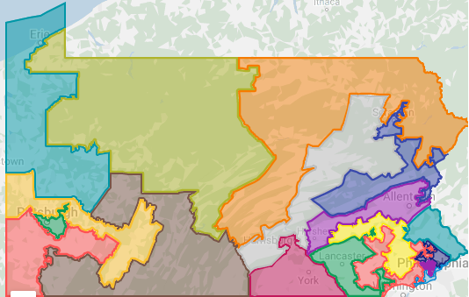
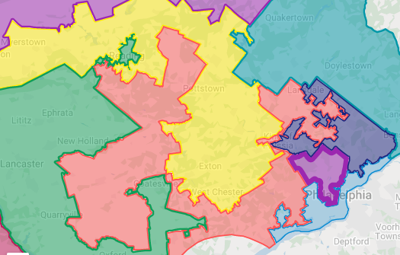
Pennsylvania’s 18 Congressional Districts
The 7th District: Goofy kicking Donald
In 2012 Republicans won 49% of the votes and claimed 72% of the seats.

Slide 4
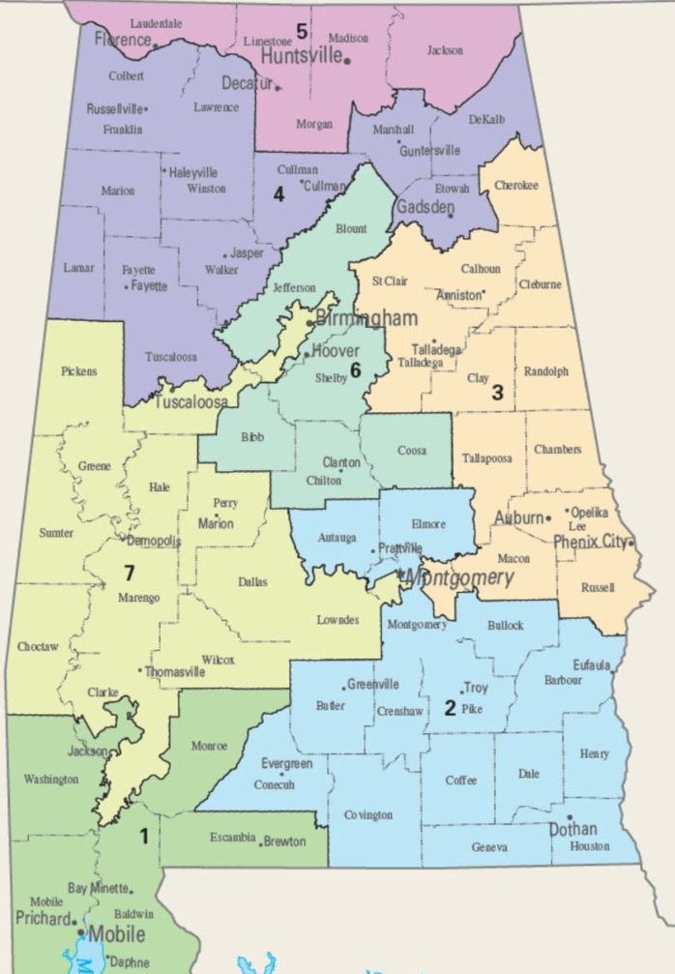
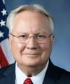

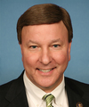



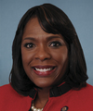
Alabama’s Congressional Districts
Alabama is 25% African-American

Slide 5
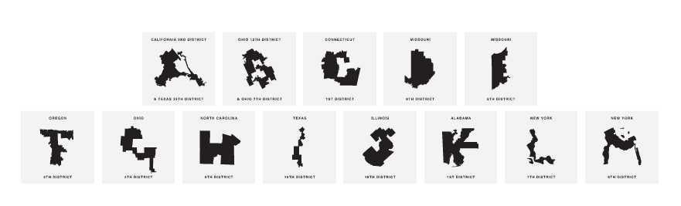
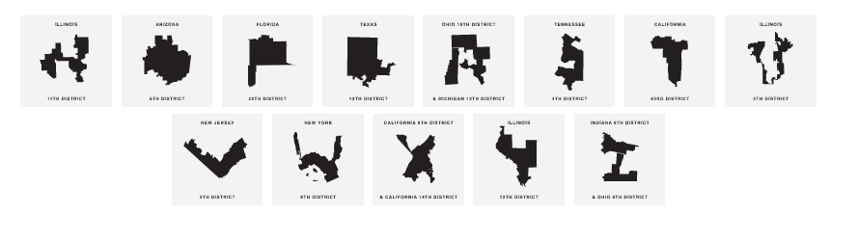
Gerry Font made from US Congressional Districts

Slide 6
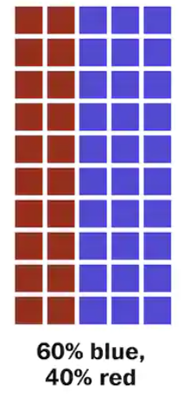
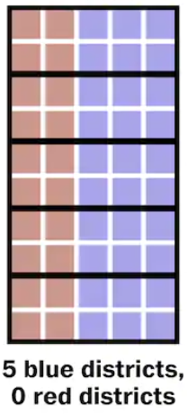
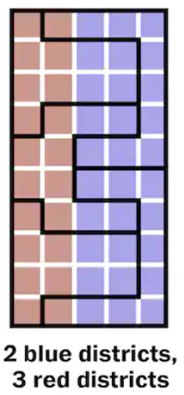
Cracking and Packing
Cracking refers to spreading supporters across districts.
Packing refers to concentrating the rival’s supporters into a few districts.

Slide 7
Previous Work on Gerrymandering
Optimal gerrymandering.
Two types of voters (Owen and Grofman 1988)
Continuum of perfectly observable types (Gilligan and Matsusaka 1999) Imperfectly observable types (Friedman and Holden 2008; Gul and Pseendorfer 2010; Kolotilin and Wolitzky 2020)
Implications of gerrymandering
Majority minority districts (Cameron, Epstein and O’Halloran 1996; Grigg and Katz 2005)
Participation (Hayes and McKee 2009) Policy choice (Shots 20002; Besley and Preston 2007) Polarization (McCarty, Pool, and Rosenthal 2009)

Slide 8
Our Contest Map
Map consists of 9 Zones partitioned into 3 equally sized Districts
Two players A & B, who are competing for a prize V
Winning the contest requires winning a majority of the Districts
Winning a District requires winning a majority of the Zones in the District
Zones are either predetermined or competitive
Competitive Zones awarded via Tullock Contest based on District Expenditure

Slide 9
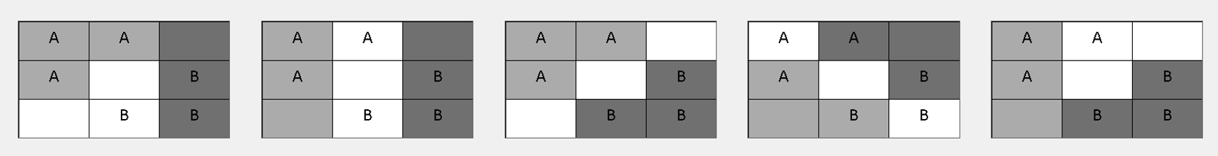
Our Contest Map
A | A
A |  | B
 | B | B
Gerrymander_{B} Symmetric_{1,1} Symmetric_{1,3} Symmetric_{3,1} Gerrymander_{A}

Slide 10
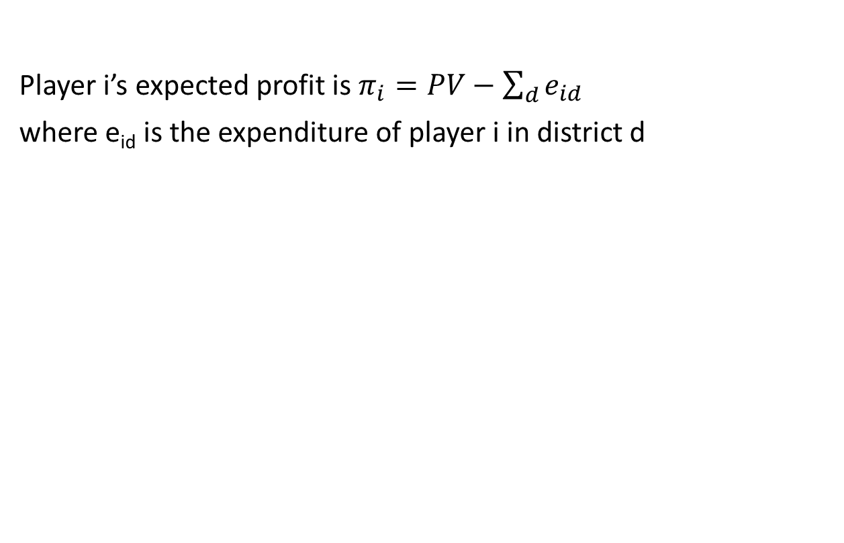
Theoretical Predictions
Player i’s expected profit is $π_{i}=PV−\sum_{d}{e_{id}}$
where e_{id} is the expenditure of player i in district d

Slide 11
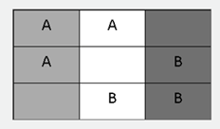
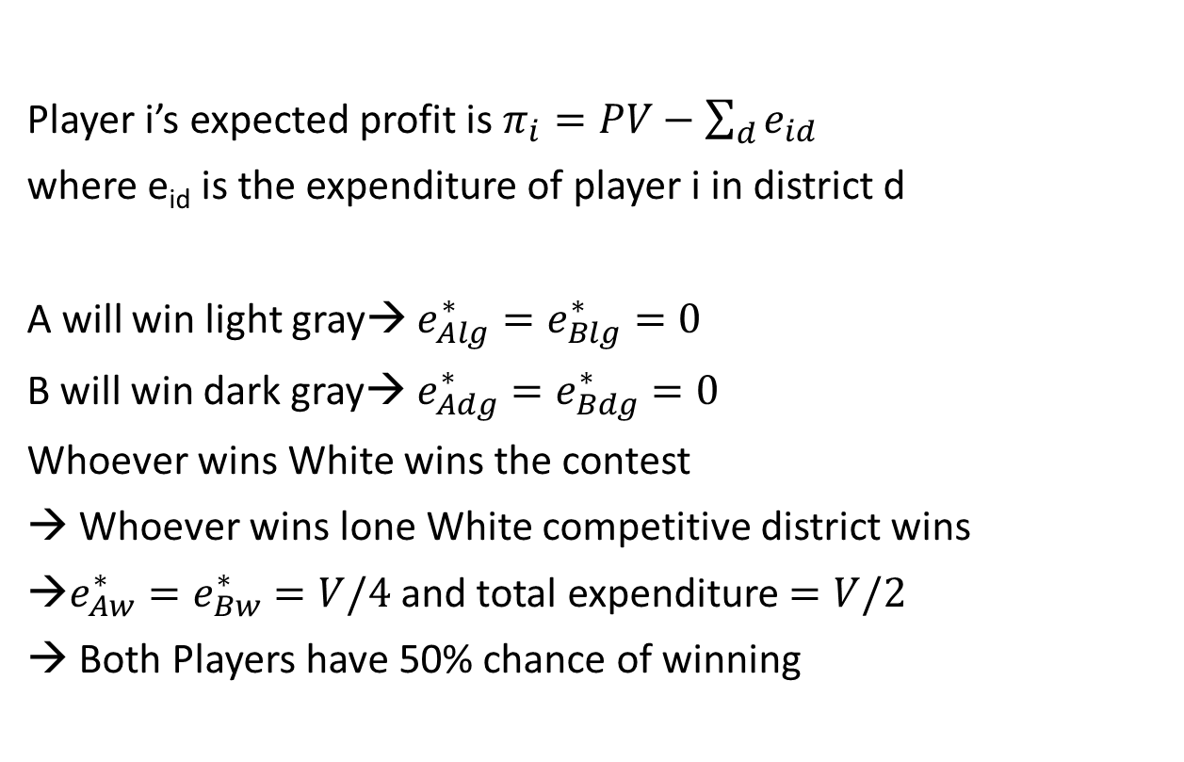
Theoretical Predictions
Player i’s expected profit is $π_{i}=PV−\sum_{d}{e_{id}}$
where e_{id} is the expenditure of player i in district d
A will win light gray→ $e_{Alg}^{∗}=e_{Blg}^{∗}=0$
B will win dark gray→ $e_{Adg}^{∗}=e_{Bdg}^{∗}=0$
Whoever wins White wins the contest
→ Whoever wins lone White competitive district wins
→$e_{Aw}^{∗}=e_{Bw}^{∗}=V/4$ and total expenditure $=V/2$
→ Both Players have 50% chance of winning
Symmetric_{1,1}

Slide 12
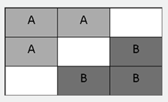
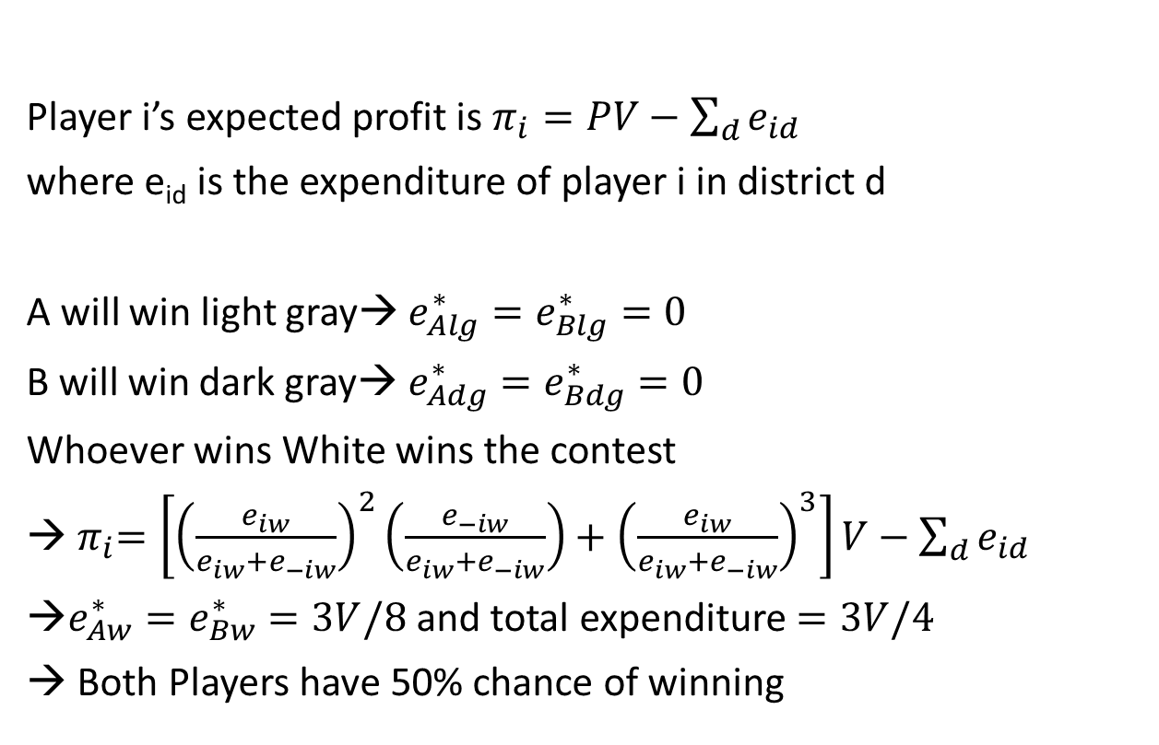
Theoretical Predictions
Player i’s expected profit is $π_{i}=PV−\sum_{d}{e_{id}}$
where e_{id} is the expenditure of player i in district d
A will win light gray→ $e_{Alg}^{∗}=e_{Blg}^{∗}=0$
B will win dark gray→ $e_{Adg}^{∗}=e_{Bdg}^{∗}=0$
Whoever wins White wins the contest
→${ π}_{i}=\left[{\left(\frac{e_{iw}}{e_{iw}+e_{−iw}}\right)}^{2}\left(\frac{e_{−iw}}{e_{iw}+e_{−iw}}\right)+{\left(\frac{e_{iw}}{e_{iw}+e_{−iw}}\right)}^{3}\right]V−\sum_{d}{e_{id}}$
→$e_{Aw}^{∗}=e_{Bw}^{∗}=3V/8$ and total expenditure $=3V/4$
→ Both Players have 50% chance of winning
Symmetric_{1,3}

Slide 13
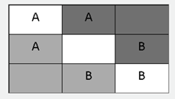
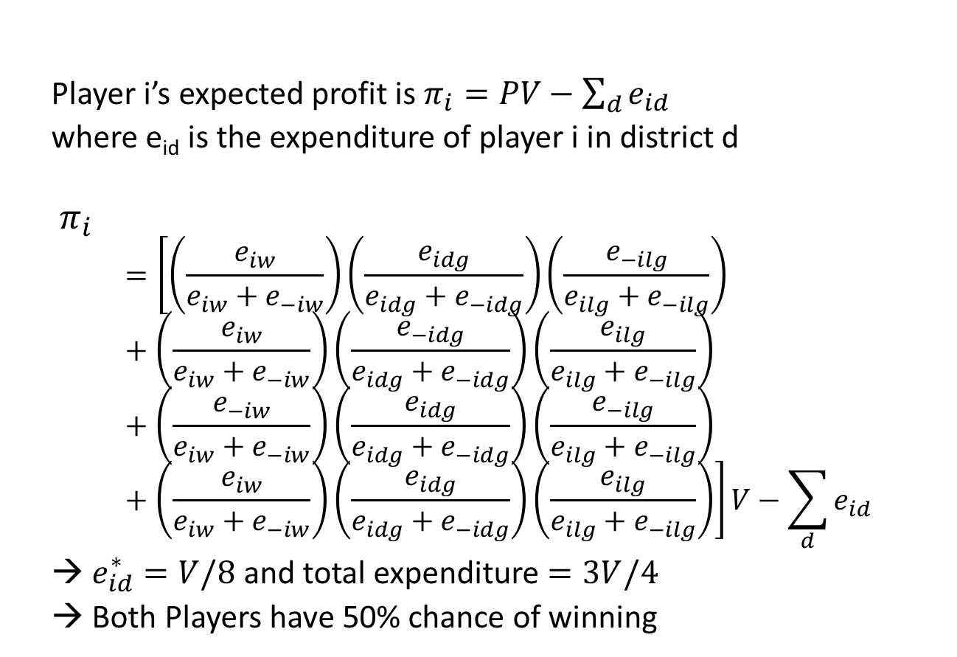
Theoretical Predictions
Player i’s expected profit is $π_{i}=PV−\sum_{d}{e_{id}}$
where e_{id} is the expenditure of player i in district d
$${ π}_{i}$$
$$=\left[\left(\frac{e_{iw}}{e_{iw}+e_{−iw}}\right)\left(\frac{e_{idg}}{e_{idg}+e_{−idg}}\right)\left(\frac{e_{−ilg}}{e_{ilg}+e_{−ilg}}\right)+\left(\frac{e_{iw}}{e_{iw}+e_{−iw}}\right)\left(\frac{e_{−idg}}{e_{idg}+e_{−idg}}\right)\left(\frac{e_{ilg}}{e_{ilg}+e_{−ilg}}\right)+\left(\frac{e_{−iw}}{e_{iw}+e_{−iw}}\right)\left(\frac{e_{idg}}{e_{idg}+e_{−idg}}\right)\left(\frac{e_{−ilg}}{e_{ilg}+e_{−ilg}}\right)+\left(\frac{e_{iw}}{e_{iw}+e_{−iw}}\right)\left(\frac{e_{idg}}{e_{idg}+e_{−idg}}\right)\left(\frac{e_{ilg}}{e_{ilg}+e_{−ilg}}\right)\right]V−\sum_{d}{e_{id}}$$
→ $e_{id}^{∗}=V/8$ and total expenditure $=3V/4$
→ Both Players have 50% chance of winning
Symmetric_{3,1}

Slide 14
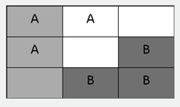
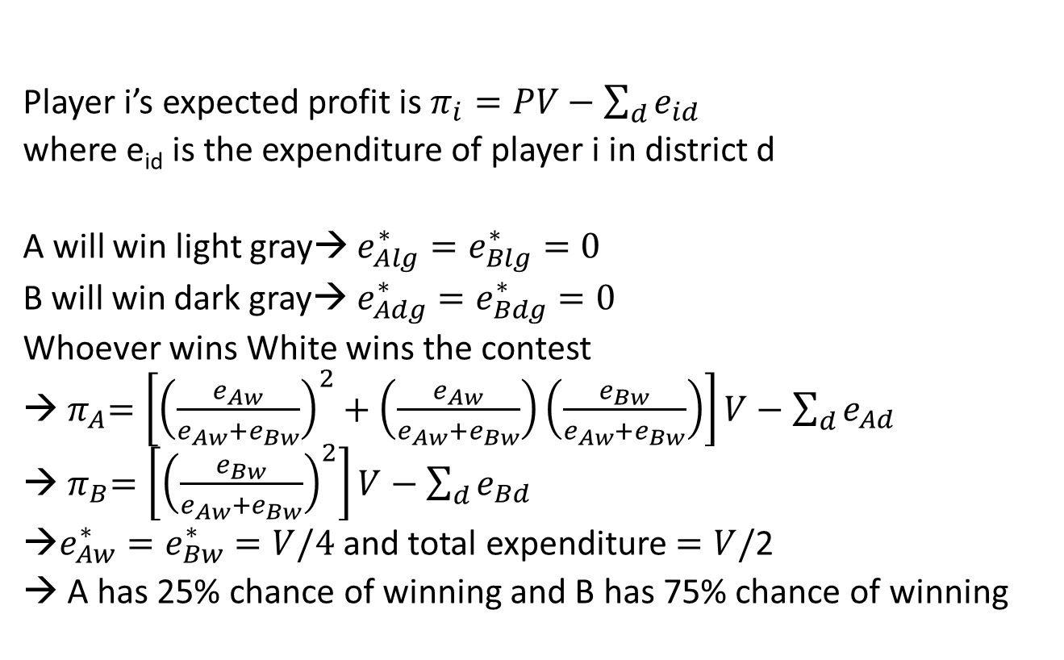
Theoretical Predictions
Player i’s expected profit is $π_{i}=PV−\sum_{d}{e_{id}}$
where e_{id} is the expenditure of player i in district d
A will win light gray→ $e_{Alg}^{∗}=e_{Blg}^{∗}=0$
B will win dark gray→ $e_{Adg}^{∗}=e_{Bdg}^{∗}=0$
Whoever wins White wins the contest
→${ π}_{A}=\left[{\left(\frac{e_{Aw}}{e_{Aw}+e_{Bw}}\right)}^{2}+\left(\frac{e_{Aw}}{e_{Aw}+e_{Bw}}\right)\left(\frac{e_{Bw}}{e_{Aw}+e_{Bw}}\right)\right]V−\sum_{d}{e_{Ad}}$
→${ π}_{B}=\left[{\left(\frac{e_{Bw}}{e_{Aw}+e_{Bw}}\right)}^{2}\right]V−\sum_{d}{e_{Bd}}$
→$e_{Aw}^{∗}=e_{Bw}^{∗}=V/4$ and total expenditure $=V/$2
→ A has 25% chance of winning and B has 75% chance of winning
Gerrymander_{B}

Slide 15
Experimental Design
Map varied within subject
8 Sessions with 8 subjects each
Session progresses in 3 Stages (14 periods with random rematching)
Stage 1: 10 periods with Random Map Selection
Stage 2: 3 periods with Own Map Selection
Stage 3: 1 period with Own Map Selection prior to Role Determination
One period (out of paid at random
V = 80, ω = 80 (exchange rate is 4 $Lab = 1 $US)
Programmed in Ztree (Fischbacher 2007)
Conducted at TIDE Lab with $5 participation payment

Slide 16
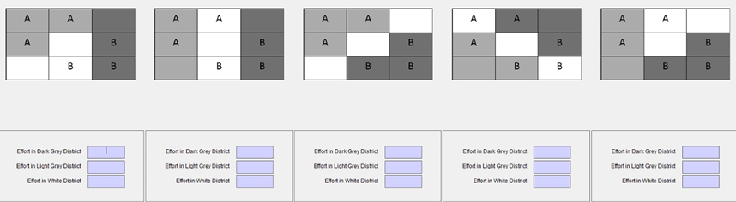
Experimental Design

Slide 17
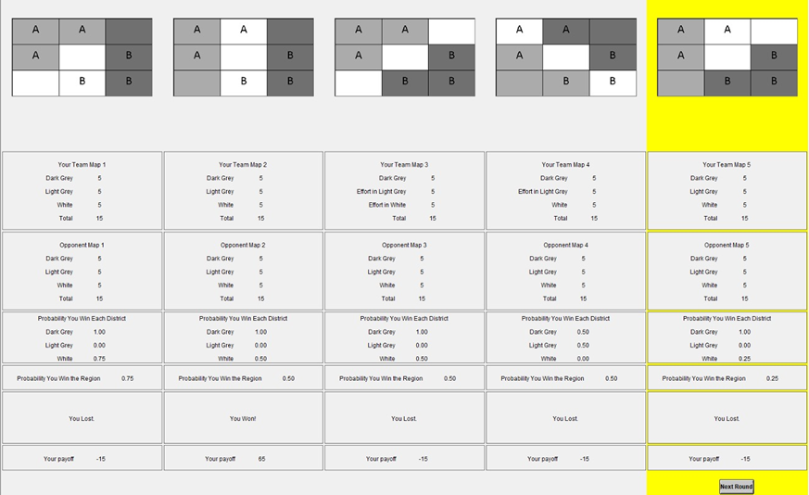
Experimental Design

Slide 18
Experimental Results – Spending in Uncompetitive Districts
In 8 districts the winner is predetermined.
In 7 districts the winner is not predetermined.
 | Gerrymander_{B} |  | Symmetric_{1,1} |  | Symmetric_{1,3} |  | Gerrymander_{A}
 | Light Gray | Dark Gray | Light Gray | Dark Gray | Light Gray | Dark Gray | Light Gray | Dark Gray
Percent of Bids = 0 | 85 | 77 | 80 | 76 | 87 | 84 | 80 | 80
 | Gerrymander_{B} | Symmetric_{1,1} | Symmetric_{1,3} | Symmetric_{3,1} |  |  | Gerrymander_{A}
 | White | White | White | White | Light Gray | Dark Gray | White
Percent of Bids = 0 | 6 | 3 | 3 | 13 | 12 | 16 | 3

Slide 19
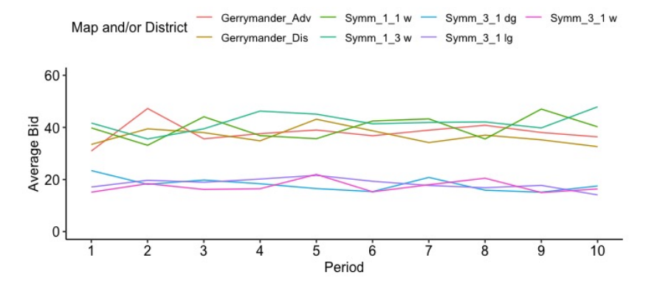
Experimental Results – Spending in Competitive Districts
Dependent Variable = Total Bid | Coefficient
Advantaged | -1.547
Disadvantaged | -4.425***
Symmetric_{1,3} | 1.172
Symmetric_{3,1} | 6.667***
Ho: | p-value
Advantaged = Disadvantaged | <0.001
Symmetric_{1,3} = 10 | <0.001
Symmetric_{3,1} = 10 | <0.001
Symmetric_{1,3} = Symmetric_{3,1} | <0.001
Subject fixed effect and standard errors clustered by session. Data from second half of stage 1.
District | Equilibrium | Observed
Symmetric_{1,3} | 30 | 43.4
Gerrymander Advantaged | 20 | 39.2
Gerrymander Disadvantaged | 20 | 36.3
Symmetric_{1,1} | 20 | 40.2
Symmetric_{3,1} | 10 | 17.6

Slide 20
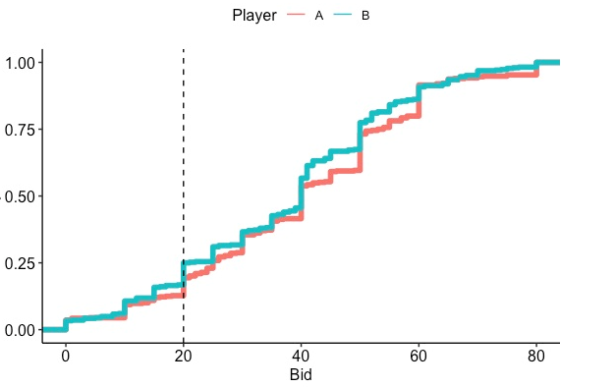
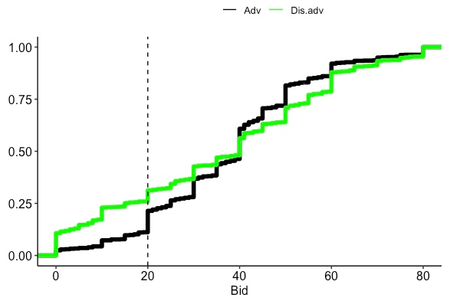
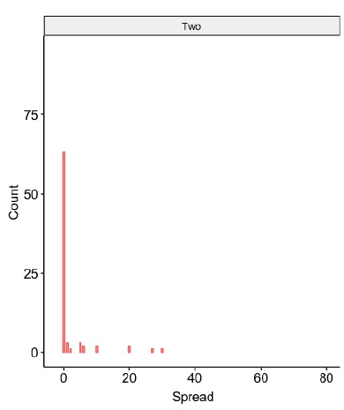
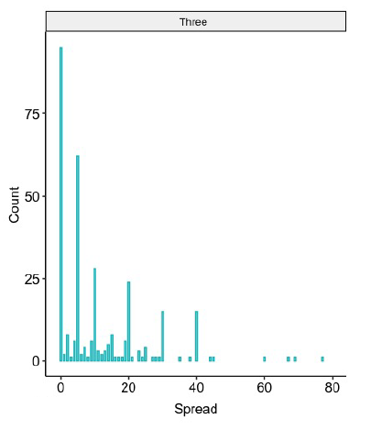
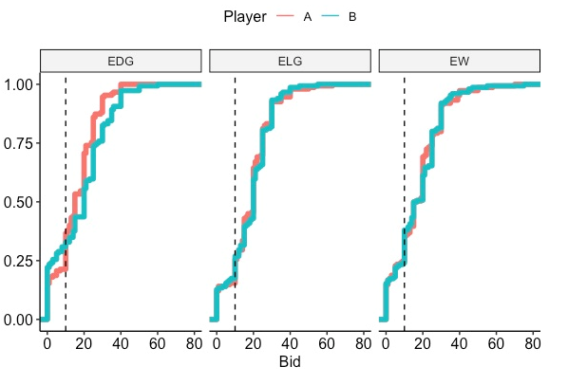
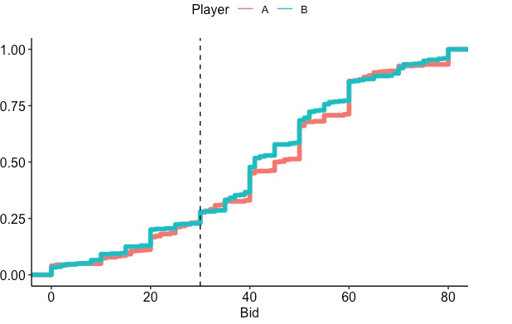
Experimental Results – Heterogeneity in Spending
Advantaged player only wins 60% of contests
Symmetric_{1,1}
Gerrymander
# of Districts | Percentage
3 | 72%
2 | 17%
1 | 3%
0 | 8%
Symmetric_{1,3}
Symmetric_{3,1}

Slide 21
Experimental Results – Opinions on Gerrymandering
After the contests subjects were asked
Do you support gerrymandering (the manipulation of the boundaries of electoral constituencies to favor one election outcome over another)?
Yes – 3 No – 61

Slide 22
Experimental Results – Map Preferences in Stage 2
Gerrymander Advantaged
Gerrymander Disadvantaged
Symmetric_{1,1}
Symmetric_{1,3}
Symmetric_{3,1}

Slide 23
Experimental Results – Politics & Gerrymandering
After the contests subjects were also asked
On a scale of 1 to 9, how would you describe your political views with 1 being extremely liberal (i.e. to the left of the Democratic Party), 5 being centrist (i.e. falling between the Democratic Party and the Republican Party), and 9 being extremely conservative (i.e. to the right of the Republican party).
1 | 2 | 3 | 4 | 5 | 6 | 7 | 8 | 9
2 | 9 | 9 | 8 | 7 | 8 | 12 | 7 | 2

Slide 24
Experimental Results – Politics & Gerrymandering
χ² test rejects gerrymandering depends on political views (p-value = 0.3106)

Slide 25
Experimental Results – Map Preferences in Stage 3
People tend to prefer symmetric maps when they do not know their role, but not the socially optimal one.
Gerrymander A
Gerrymander B
Symmetric_{1,1}
Symmetric_{1,3}
Symmetric_{3,1}

Slide 26
Summary
Subjects bid in an intuitive way - (largely) ignore non-competitive districts - (over)bid on competitive districts on average - Symmetric_{3,1} and Symmetric_{3,1} are treated similarly - evidence in Symmetric_{3,1} for minimal winning coalitions - gerrymandering leads disadvantaged people to be discouraged on average
Views on gerrymandering - report not liking gerrymandering, regardless of political persuasion - prefer to compete on (inefficient) “fair” maps when they cannot be self-serving - overwhelmingly engage in gerrymandering when they can

